Slide 1
Find && Park
https://github.com/raghakot/facebook-hackathon

Slide 2
Problem
Seattle ranks 5th among big U.S. cities for the amount of time spend searching for open parking spaces (58 hrs on avg per year)
Limitations of detecting availability using transactional data (from seattle.gov)
No records for RPZ and illegally parked cars
Cars depart early
No data for free parking zones
Our Approach: Use camera on parking lots to detect occupancy in real time.
Notes:
Mention existing approaches

Slide 3
Vision
Parking app showing real time availability. We can build a statistical model using this information to predict future availability.
Can show directions to an available parking lot near some search location.
Single camera can cover a large lot as opposed to using lot sensors
No need of multiple gate sensors at various entrances.

Slide 4
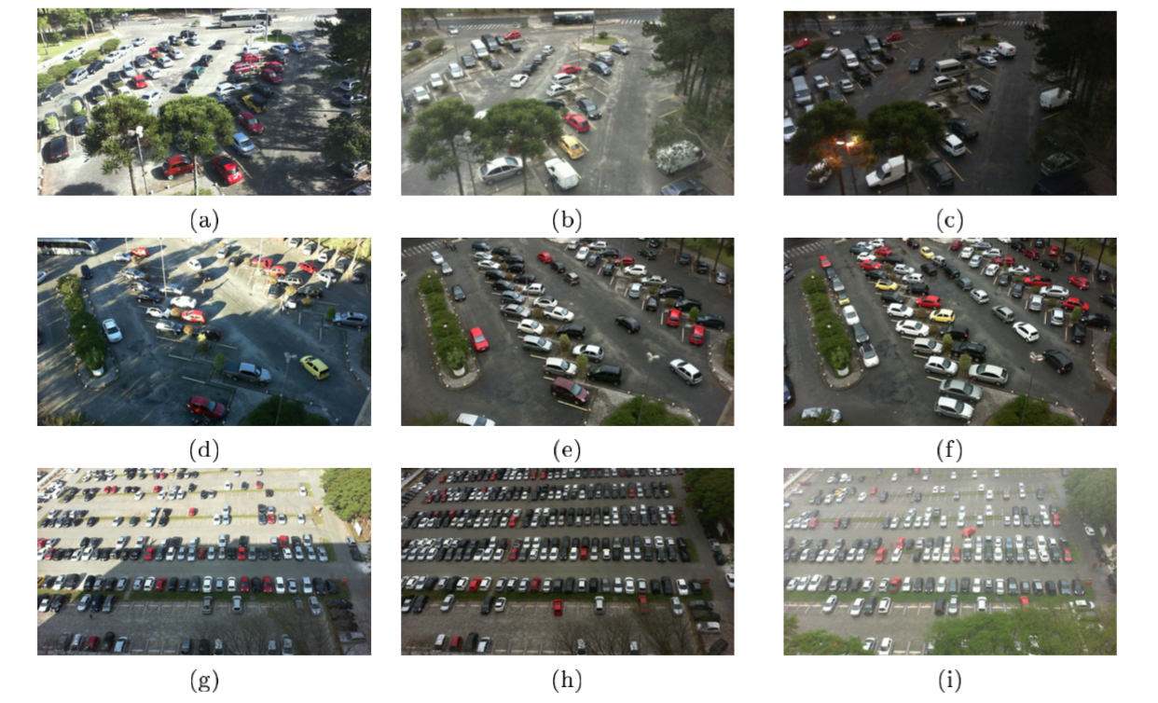
Dataset
PKLot Dataset: https://web.inf.ufpr.br/vri/databases/parking-lot-database/

Slide 5
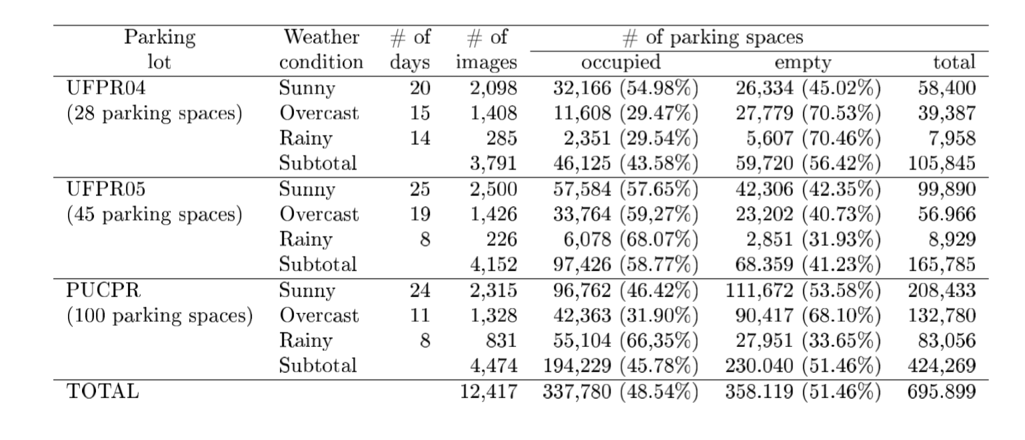
Data Statistics

Slide 6
Goal
Train a model to predict number of occupied spots from image
Holdout test set of 10% stratified across lot type and weather conditions
Val split of 10% from remaining data for hyperparamater search and guiding model development.
Metrics
Loss: Avg Mean Squared Error
Interpretable Metric: Avg Mean Absolute Error

Slide 7
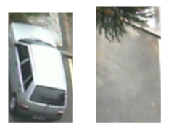
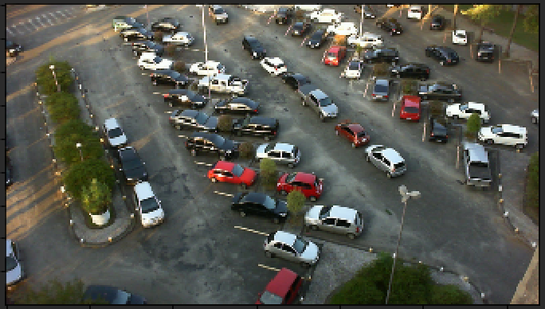
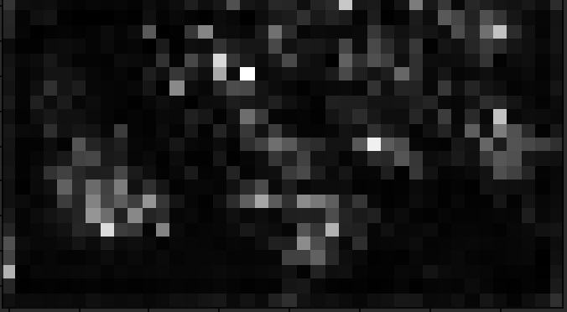
Model1
Trained with binary cross entropy
Labels are balanced
Achieves 99% accuracy on test set
Image augmentation with rotations as rand(0, 8) * 45 deg
1. Train Binary model M1
FCN
Binary Network
0 – Vacant
1 - Occupied
Conv layer with sigmoid
to mimic mask
2. Apply m1 on whole image
Slide M1
Magic count function
Generates mask (hopefully)
Occupied Count

Slide 8
Magic count function
Count Layer: Sum over w, h of Sigmoid 1 filter Conv activations.
Mask refinement via 2 Conv layers followed by Sigmoid Conv layer for final sharpened mask.
Use MLPs – We didn’t try this since mask has a spatial behavior.
1, 3 X 3
Conv
(Hopefully sharpened mask)
4, 3 X 3
Conv
4, 3 X 3
Conv

Slide 9
Model2 - Learn everything end-end
No pretrained binary model
Hopefully the network structure encourages Sigmoid Conv label prior to count layer to act as car mask detector – We are injecting domain knowledge into network architecture.
Conv layer with 1 filter and sigmoid activation
to mimic mask
CNN
Magic count function
Generates mask (hopefully)
Occupied Count

Slide 10
Results
M1 - Pretrained binary weights (frozen) + refinement Conv + count layer
M1 - Pretrained binary weights (trainable) + refinement Conv + count layer
M3 – End-End model with Count layer
M4 – End-End model with refinement Conv + Count layer
 | Avg Mean Squared Error (Train, Val, Test) |  |  | Avg Mean Absolute Error (Train, Val, Test)
M1 (3 epochs, Terminated due to overfitting) | 3859.59 | 656.50 | N/A | 59.23 | 21.92 | N/A
M2 (35 epochs) | 23.21 | 19.15 | 22.04 | 3.96 | 3.62 | 3.78
M3 (13 epochs, Terminated due to lack of time) | 76.84 | 62.2 | 63.8 | 5.73 | 5.32 | 5.38
M4 (31 epochs) | 17.77 | 19.85 | 16.73 | 3.73 | 3.56 | 3.38

Slide 11
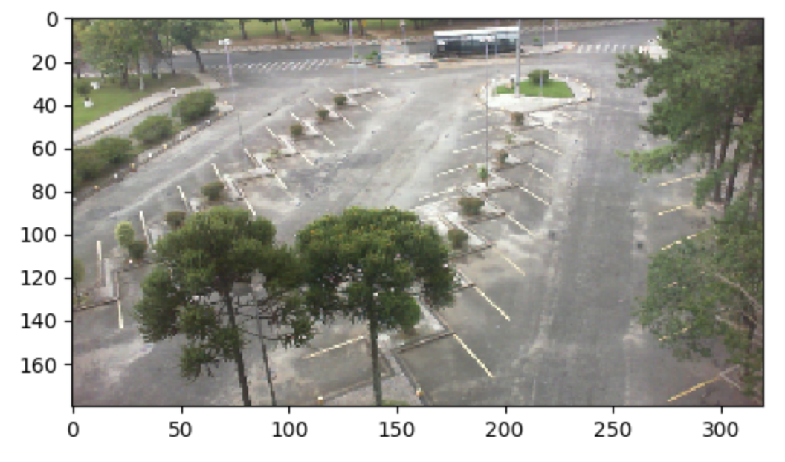
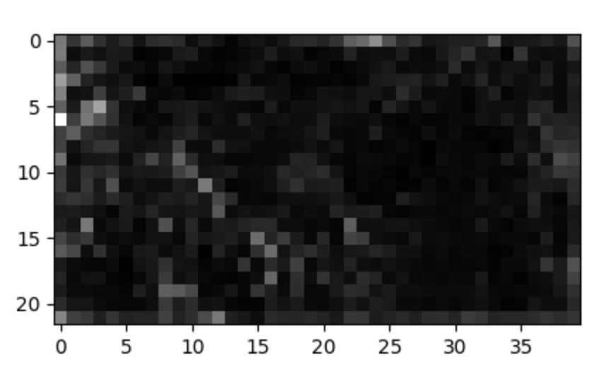
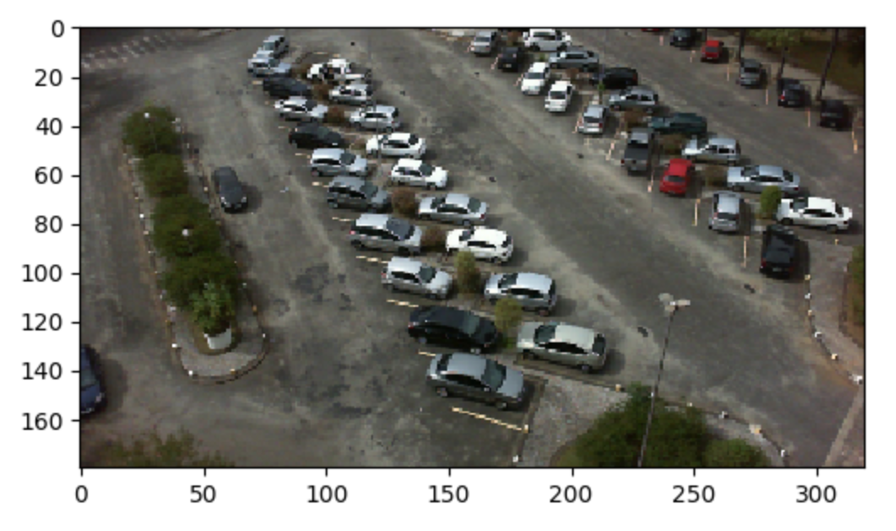
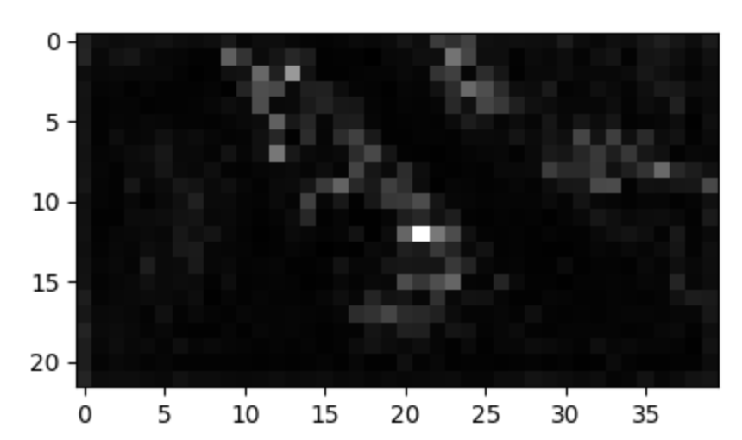
Does end-end model learn bounding boxes?
Surprisingly, Yes!!!

Slide 12
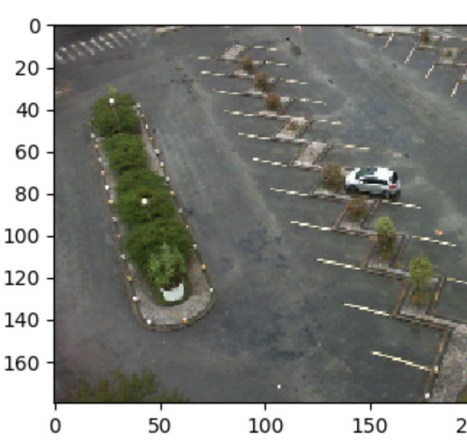
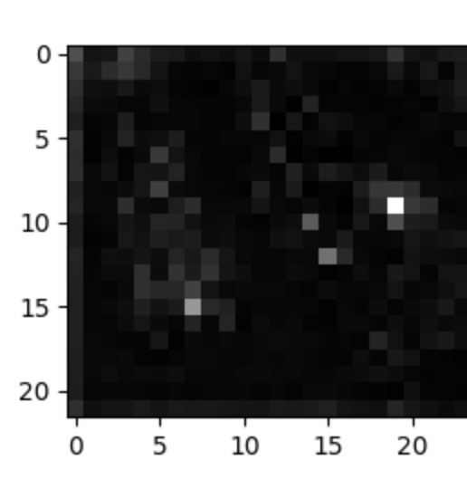
Bloopers

Slide 13
If we had more time
Use two output heads for refinement model to get around sigmoid gradient propagation slowdown
Try learning a model with multiple output heads (mask output and regression output) trained with binary cross entropy and MSE
Try learning with multiple input heads (Segmented car / vacant lot and Full image) and supervise losses for masking and counting separately.
4, 3 X 3
Conv
4, 3 X 3
Conv
Count Layer
Loss
Loss
Count Layer

